Slide 1
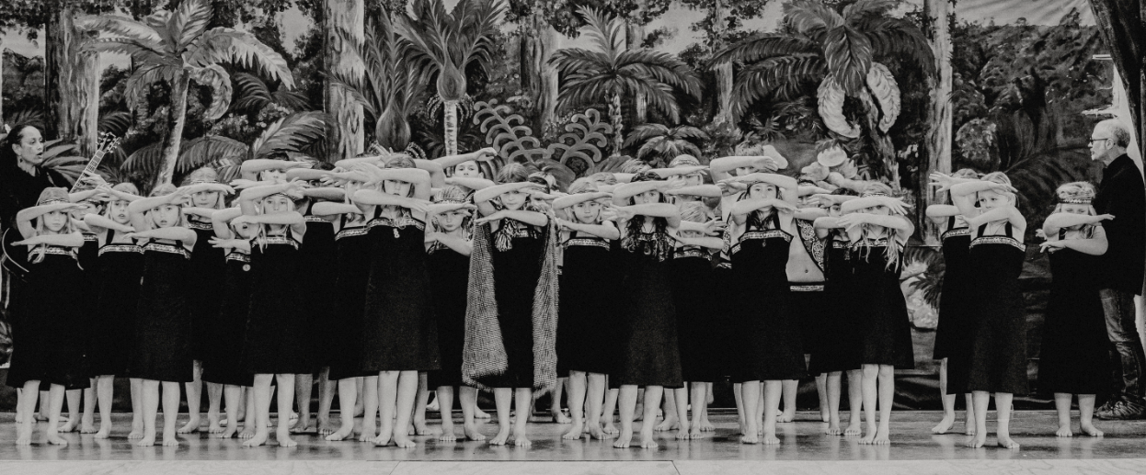

Slide 2
Karakia
Kia hora te marino
May peace be widespread
Kia whakapapa pounamu te moana
May the sea be like greenstone
Hei huarahi ma tatou i te rangi nei
A pathway for us all this day
Aroha atu aroha mai
Give love, receive love
Tatou i a tatou katoa
Let us show respect for each other

Slide 4
Waiata
Te Aroha
Utaina
Tutira mai
Tōia mai te waka
Nga iwi e
Toro mai tō ringa
Hareruia
Haere mai
He aha te hau
National anthem

Slide 5
Haka
He Manu Ka Rere (Nā Kereama Nathan 2014)
Kai a te rangatira he kupu, he reo
Kai a te manu he kōrari, he miro
Ki te kai i te miro
Homai te ngāhere
Ki te kai i te mōhio
Homai te ao
He manu huruhuru
E rere, e rere
He manu huruhuru
Kōkiri e

Slide 6
Ka mate
Taringa Whakarongo
Ka rite Ka rite Kia Mau!
Hei! Ring ringa Pakia
Wae wae takahia kia kino Nei hoki
Ka mate! Ka mate! Ka ora! Ka ora!
Ka mate! Ka mate! Ka ora! Ka ora!
Tenei te tangata puhuru huru
Nana nei i tiki mai
Whakawhiti te ra
A upa … ne! ka upa … ne!
A upane kaupane whiti te ra!
Hi !!!
Listen
Get Ready
slap hands
I die! I die! I live! I live!
I die! I die! I live! I live!
This is the hairy man
Who fetched the Sun
And caused it to shine again
One upward step! Another upward step!
An upward step, another.. the Sun shines!!

Slide 7
Karanga - Kōtiro
Haka - Tama
Tauawhi mai ra nga tipuna o Aotearoa
Kia piri kia tata mai ra ki taku taha e
Nau mai! Haere mai!
Hoki mai ra eeee!
E te rangatahi e haruru nei.
I Au! Au! Auē! Ha!
Ngā tamariki! Hi!
Ngā tamariki! Hi!
Aki - Akina! Hi!
Hikitia! Hi!
Au! Au! Auē! Ha!
Ngā tamariki! Hi!
Ngā tamariki! Hi!
Aki - Akina! Hi!
Hikitia! Hi!
Ko te mana o te iwi e ngunguru nei!
E Au! Au! Auē! Ha!
Hi

Slide 8
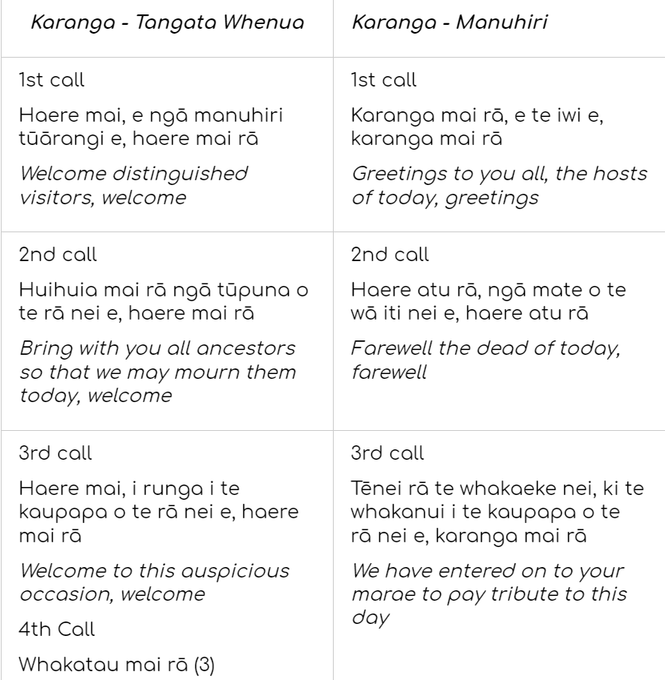
Karanga

Slide 9
Te Aroha

Slide 10
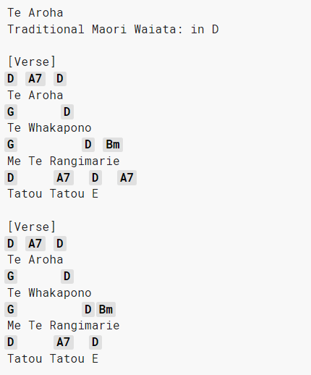
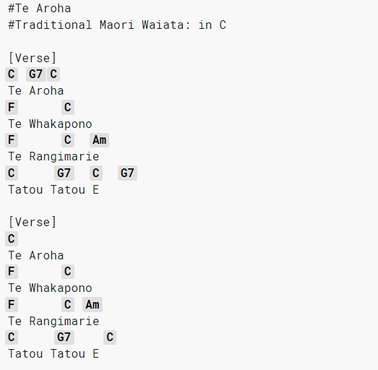
Te Aroha Chords

Slide 11
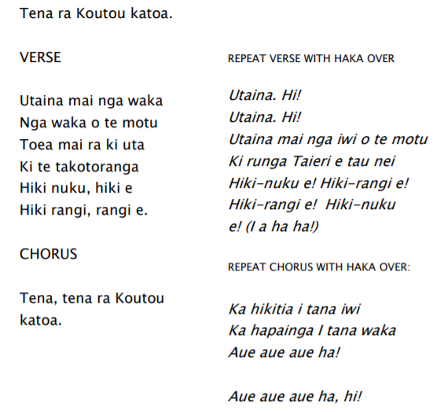
Utaina

Slide 12
Tutira mai

Slide 13
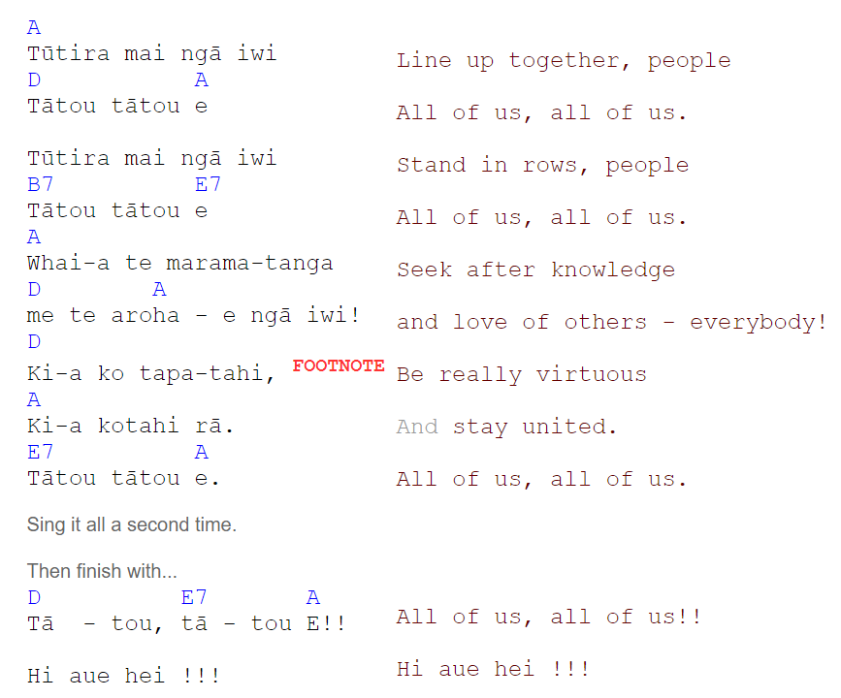
Tutira mai chords

Slide 14
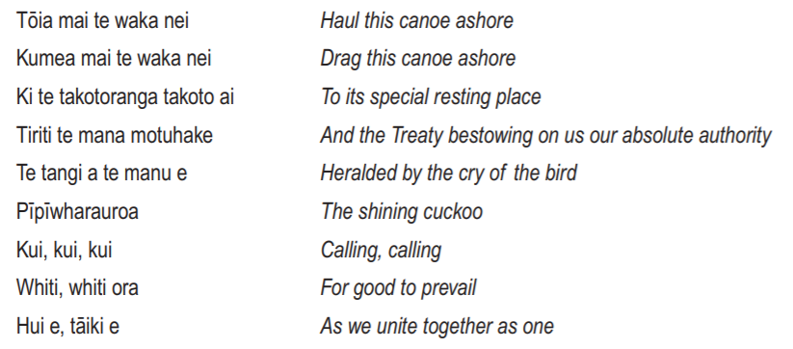
Tōia mai te waka
Actions in te reo

Slide 15
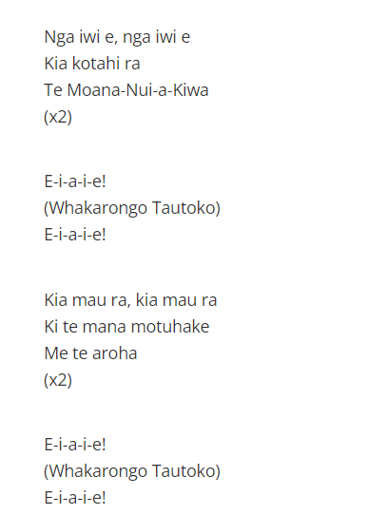
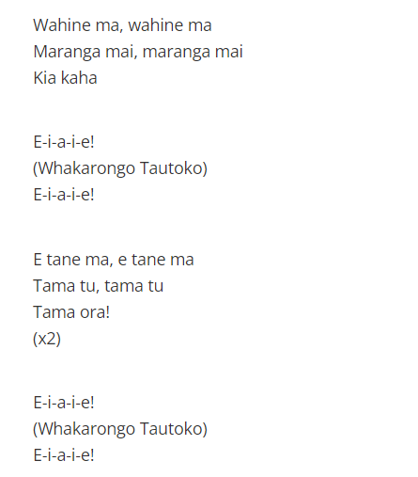
Ngā iwi e
E hine ma, e hine ma
E tama ma, e tama ma
Actions

Slide 16
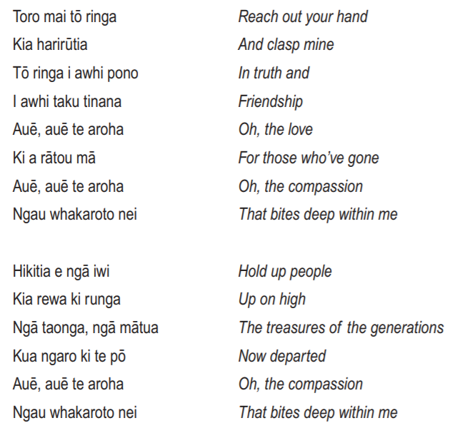
Toro mai tō ringa
Actions

Slide 17
Hareruia
Rotorua Boys do Hareruia
Auckland Girls do Hareruia

Slide 18
Haere mai
Haere mai (haere mai)
Haere mai (haere mai)
E ngā iwi e
Haere mai
Ki runga ō te marae
Hui mai tātou katoa (tātou katoa )
E hine mā (e hine mā)
E tama mā (e tama mā)
Hapainga o te mana Māori e
Kia rewa runga rawa
I ahaha
E ngā iwi e
Haere mai, haere mai, haere mai

Slide 19
He aha te hau
He aha te hau
He aha te hau e wawara mai
He tiu, he raki
Nāna i a mai te pūpū-tarakihi ki uta
E tikina
atu e au te kōtiu
Ko ia te pou, te pou whakairo
ka tū ki Waitematā
I ōku wairangi ee
Kōkiri!

Slide 20
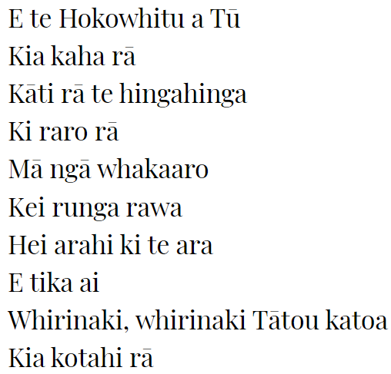
E te Hokowhitu

Slide 21
National Anthem

Slide 22
Waiata ahau
Waiata ahau
Ki a Ihowa
Waiata ahau
Ki a Ihu
Ka tangi te manu tioriori
E te Ariki, E te Ariki
Waiata Ahau guitar

Slide 23
Lockdown Kapa Haka
Nga iwi e (chords)
Te Aroha (Chords)
He Honore (chords)
Haere mai (chords)
Whakataka te hau (chords)

Slide 24
2021
Ka mate
Utaina
Mau rakau ****
Tika Tonu detail
Utaina Utaina actions
E waka eke noa Haere Mai
Whakataka te hau
School Mihi
He aha te hau
Toro mai to ringa with chords
Hokowhitu (harmonic resonators)
Haka - Ka mate/ He Manu Ka Rere

